Slide 1
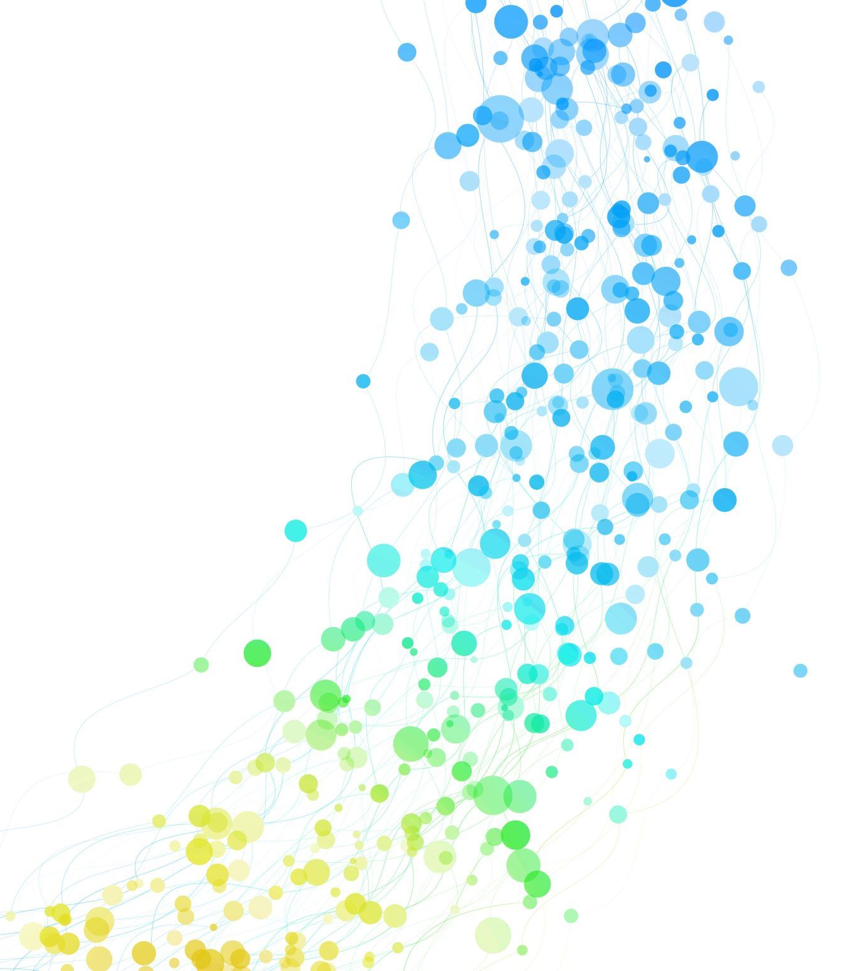
Crip Theory
Matthew Bencker

Slide 2
Agenda
What is Crip Theory
Key Concepts of Crip Theory
Limitations of Crip Theory

Slide 3
What is Crip Theory?
Crip theory challenges traditional understandings of disability by analyzing how societal norms, structures, and power dynamics shape the experiences of disabled individuals.

Slide 4
Key Concepts
"To Crip"
Crip Failure
Crip Time
Cripestmology
Compulsory able bodiedness and able mindness
Forced Intimacy

Slide 5
" To Crip"
It means to engage in activities, discussions, or actions that challenge ableism, advocate for the rights and dignity of disabled individuals, and promote disability justice.
"For instance, higher education syllabi, graduation requirements, and accommodation disclosure requirements can be cripped for ableism that defines students’ experiences and identities."(Abes & Wallace, 2020)

Slide 6
Crip Failure
It describes instances where accommodations or accessibility measures fail to adequately meet the needs of disabled individuals, resulting in barriers to participation or access.
Understanding and addressing crip failures requires ongoing dialogue, collaboration, and proactive efforts to identify and rectify barriers to access and participation for disabled individuals.

Slide 7
Crip Time
Looks at the notion of time as a linear construct and showcases the ways in which time is experienced differently by disabled individuals.
Crip Time acknowledges and values the diverse experiences of disabled people, recognizing that timelines and expectations imposed by ableist norms may not align with their needs or realities.

Slide 8
Cripstemology
It challenges traditional frameworks of knowledge that may exclude or marginalize disabled voices and ways of knowing.
It also recognizes that disabled people often possess unique insights and knowledge about their own experiences, and the world around them, which may differ from dominant, ableist perspectives.

Slide 9
Compulsory Able-Bodiedness and Able- Mindness
Compulsory Able- bodiedness refers to the societal expectation that everyone should have a normative, non-disabled body and be able to perform tasks and activities without limitations.
It implies that disability is seen as deviant or undesirable, and individuals who do not meet able-bodied norms may face discrimination, exclusion, or pressure to hide or "overcome" their disabilities.
Compulsory Able Mindness refers to the societal expectation that everyone should have normative cognitive abilities and conform to standards of mental health and neurotypicality.
This concept reflects the stigma and discrimination faced by individuals who may be seen as incompetent, irrational, or undesirable by society.

Slide 10
Forced Intimacy
"The common, daily experience of disabled people being expected to share personal parts of ourselves to survive in an ableist world. This often takes the form of being expected to share (very) personal information with able bodied to get basic access, but it also includes forced physical intimacy, especially for those of us who need psychical help that often require touching of our bodies. "(Abes et al., 2019)

Slide 11
Limitations
Physical VS Invisible Disabilities
Intersection of other identities
Cycle of Marginalization and Silencing

Slide 12
Crip Camp Documentary
https://www.youtube.com/watch?v=OFS8SpwioZ4
Notes:
Opening and 44.11-46.31

Slide 13
MDA summer camp
https://www.mda.org/summer-camp

Slide 14
References
Abes, E. S., & Wallace, M. M. (2020). Using Crip theory to reimagine student development theory as disability justice. Journal of College Student Development, 61(5), 574–592. https://doi.org/10.1353/csd.2020.0056
Abes, E. S., Jones, S. R., & Stewart, D. L. (2019). Rethinking college student development theory using critical frameworks. Stylus Publishing, LLC.
Crip Camp: A Disability Revolution. (2020). Netflix. Retrieved from https://www.youtube.com/watch?v=OFS8SpwioZ4.

